Slide 1
Instant Messaging
Notes:
Instant Messaging is the exchange of typed messages between computer users in real time via the Internet.
Online 'chat' includes web-based applications that allow communication between users in a multi-user environment. Often these communications are anonymous, although they are don’t have to be.
In my presentation, I am going to talk not only about what Instant Messaging is but what we can use it for and how it is being used in the library field. I even have a short video at the end.

Slide 2
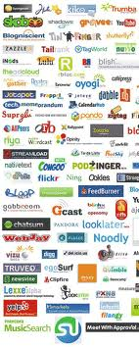
Instant Messaging is just one of the tools in the Social Media Toolbox
Notes:
IM is also a part of Social Media or what we so often call, affectionately or sometimes nonaffectionialy, Web 2.0. As you can see from the graphic, Social Media is huge. It includes some things that we think are pretty common.
These are the ones we are most familiar with but it is not limited to:
Blogs
Wikis
Facebook
MySpace
Twitter
LinkedIn
FourSquare
Posterous
Yahoo and AOL groups
Google+ Hangout
Podcasting
Videocasting
And I’m sure you guys can add lots more to this.
There is more social media than we can keep track of since new ways of interacting online are being created every day.

Slide 3
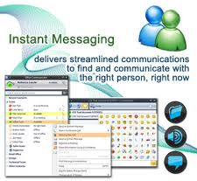
Advantages
Notes:
There are a number of things that Instant Messaging is very good at:
Education Advantages
Users may already be comfortable with it
Can be used inside or outside the classroom
Ease of communication with “canned” answers – which is great for the library where many questions are pretty simple ones like when is the library open and how do I check out a book.or the person next to me is being really, really loud can you ask them to be quiet
Business Advantages
Messages can be tracked for Analytics
Flexible
Works anywhere
Can be used between clients as well as between coworkers
Both
Instant Communication Suited for quick informational type questions Non-locational specific so it can be routed to cell phones Can be used for meetings Can send links, image, videos and filesharing Can be used in intranet as well as internet Need not travel to attend meetings Personal anonymity Conversations are easily tracked Analytics are easy

Slide 4
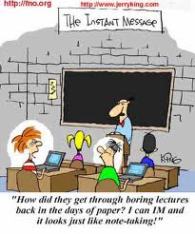
Disadvantages
Notes:
There are some marked disadvantages though!
No way to relay emotional content unless you use those silly emoticons No personal interaction as in FtF Long sustained conversations may be difficult or time consuming May be hard to understand if texting shorthand is used Can not hide presence if you are actively available for IM Potential viruses if receiving links, files or videos Multitasking is easy – as in not paying attention to the meeting at hand May have security issues, although most have encryption

Slide 5
How does it work?
Provider
Software
User
Internet access
Url to institution’s library
Notes:
You need a provider – your provider may be
Free and/or open source or it may be a service and/or software you purchase
It may be web based – meaning that you do not have to download any software
It may be downloaded onto your server or computer
And you need a user with internet access.
In the case of the library – you need access to your ilibrary’s url or homepage.
If library access is located behind a portal – you will need access to the portal

Slide 6
Paid and Unpaid Software choices
Notes:
Unpaid
Trillian
Aim
Skype
Pidgin (open source)
Adium (open source)
Fire (open source)
Miranda (Microsoft only)
Facebook and MySpace but you must have an account to use them.
The most popular program for libraries was Meebo which was purchased by Google and replaced with Google+ Hangout. Needless to say we are scrambling for a good new service. Hence this class project!
Paid
LibraryH3lp
Mosio (Text a Librarian), we use this one and it’s awkward at best
For business
BigAnt (Small Ant, Big Dream)
PinkNotes Plus
Paid clients, however, tend to provide better privacy to the users and the institution or business

Slide 7
Statistics
Teens, Tweens and Young Adults
65% IM or Text
35 % use cellphones for verbal communication
6% use email
Notes:
You didn’t think we could get through this program without statistics, did you?
These have been our primary users in the library, whether academic or public
As far as we can tell – no one uses snail mail…except when forced by parents to write thank you notes for birthday and Christmas gifts!

Slide 8
More Statistics
In 2009
47 billion IM were sent
2.5 billions IM accounts were opened
68% were private IM’s
32% were business IM’s
Notes:
2011 – 45% of mobile phone users im
35% of US adults ages 30-49 use their phone to im others
And 5.7 Trillion messages were sent
It is estimated that by 2013 there will be 1.7B users using IM globally

Slide 9
Bibliography
“Amazing Facts and Figures about Instant Messaging (Infographic).” Pingdom.com. 2010. Web. 30 Nov. 2012. < http://royal.pingdom.com/2010/04/23/amazing-facts-and-figures- about-instant-messaging-infographic/>
“Instant Message.” Online video clip. Youtube. Youtube, n.d. Web. 30 Nov. 2012
All images found at images.google.com
Complete bibliography can be found at imbyjoeym@weebly.com
Notes:
All this info will be found in my e-portfolio at IMbyJoeyM.weebly.com
http://www.youtube.com/watch?v=y2RJL9_0xX8

